Slide 1
Water Quality Analysis using Google Earth Engine and Sentinel-2 Imagery
Understanding the Normalized Difference Turbidity Index (NDTI)
Notes:
Slide 1: Introduction to NDTI
- Title: "Understanding the Normalized Difference Turbidity Index (NDTI)"
- Briefly explain what NDTI is and its purpose
- Mention that it is an index derived from satellite imagery or remote sensing data
- Explain that NDTI is used to quantify water turbidity or cloudiness, which can be caused by suspended particles, such as sediment, algae, and other organic materials

Slide 2
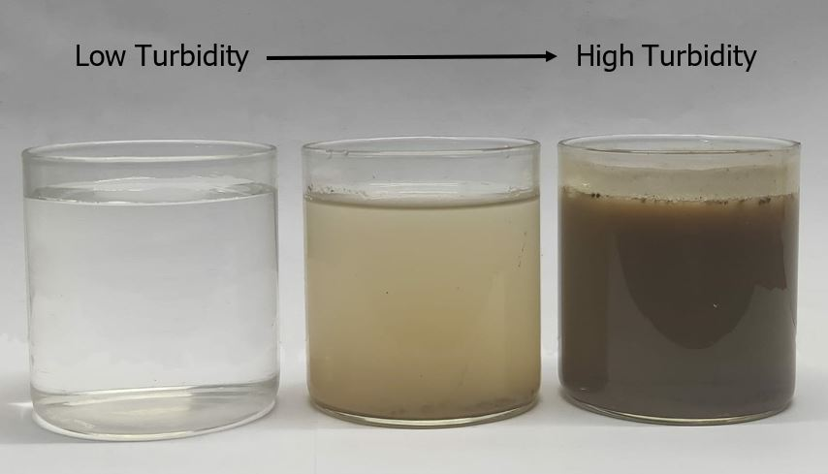
Turbidity
Represents the level of suspended sediments in water
Traditionally field measurement expensive, time and labor intensive,
Notes:
Slide 2: NDTI Calculation and Interpretation
- Title: "Calculating and Interpreting NDTI"
- Describe the NDTI formula and the bands used in its calculation
- Explain the NDTI value range, from -1 to 1, and how higher positive values indicate higher turbidity
- Mention how NDTI values can be compared over time to identify trends, monitor water quality, and detect pollution events

Slide 3
Normalized Difference Turbidity Index (NDTI)
A satellite-based index for mapping water body turbidity
Uses the phenomenon that the electromagnetic reflectance is higher in green spectrum than the red spectrum for clear water
calculated as (red_band - green_band)/(red_band + green_band)
Ranges from -1 to 1
Notes:
Slide 2: NDTI Calculation and Interpretation
- Title: "Calculating and Interpreting NDTI"
- Describe the NDTI formula and the bands used in its calculation
- Explain the NDTI value range, from -1 to 1, and how higher positive values indicate higher turbidity
- Mention how NDTI values can be compared over time to identify trends, monitor water quality, and detect pollution events

Slide 4




Tools Used
Google Earth Engine (GEE)
Python Earth Engine API
Folium
Branca
Streamlit
GeoPandas
Notes:
- Title: "Tools and Libraries for NDTI Analysis"
- Provide an overview of the main tools and libraries used in the code, explaining their roles and functionalities:
1. Google Earth Engine (GEE):
- A cloud-based platform for planetary-scale geospatial analysis
- Used for accessing, filtering, and processing the Sentinel-2 satellite imagery
2. Python Earth Engine API:
- A Python library for interacting with Google Earth Engine
- Facilitates image processing, feature extraction, and data analysis
3. Folium:
- A Python library for creating interactive maps using Leaflet.js
- Used for visualizing the satellite images, water bodies, and NDTI results on a dynamic map
4. Branca:
- A Python library for creating advanced components, such as color maps and legends, for use in Folium maps
- Used for generating a color-coded legend for the NDTI values on the map
5. Streamlit (optional, if you used it for creating a web app):
- A Python library for building interactive web applications quickly
- Used for creating an easy-to-use interface for inputting parameters and displaying the resulting map

Slide 5
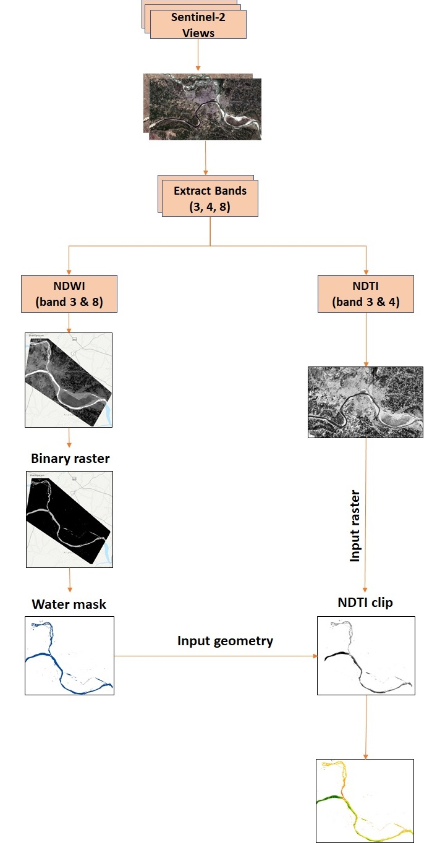
Workflow
How to calculate NDTI
Notes:
- Title: "NDTI Analysis Using Python and Google Earth Engine"
- Briefly describe the main components of the code:
- Collecting Sentinel-2 satellite images
- Calculating NDTI
- Clipping NDTI to water bodies using NDWI
- Normalizing and visual

Slide 6
Practical Applications and Future Improvements
monitoring water quality
detecting pollution events,
tracking sediment transport
identifying seasonal patterns in water quality
Checking for erosion, algal blooms
Notes:
Slide 4: Code Walkthrough
- Title: "Step-by-Step Code Walkthrough"
- Walk the audience through the key sections of the code, explaining the purpose and functionality of each section
- Input parameters (coordinates, date range, buffer size)
- Fetching Sentinel-2 images and filtering based on the input parameters
- Calculating NDTI and NDWI, and masking NDTI to water bodies
- Normalizing and stretching NDTI values for visualization
- Adding layers to the interactive map, including Sentinel-2 images, water bodies, and NDTI results
- Creating a colormap for NDTI values and adding it as a legend to the map

